Slide 1
Post-Pandemic Scenario Planning
Training for participants

Slide 2
TOPICS COVERED
Introduction to Scenario Planning Framework
The Focal Issue
Key Factors
External Forces
Critical Uncertainties
Scenario Logics

Slide 3
TOPICS COVERED
7. Scenario Stories
8. Implications and Options
Early Indicators
Evaluation of your Scenarios
The Four Rs
Project Timeline
Additional Examples and Resources

Slide 4
Keep in mind…
“But, of course, you can never identify all the forces at play. If you could, and see their interactions, then real prediction of the future would be simple. This is never likely to be possible, and furthermore, there are some situations that balance on a hair’s breadth.”
—Jimmy Davidson, head of group planning at Royal Dutch Shell, 1967–1976

Slide 5
SCENARIO PLANNING - INTRODUCTION
Strategic planning framework for uncertain circumstances
Objective: to determine and elaborate a small series (usually 2-5) of plausible scenarios as outcomes of a very limited (usually 2) set of critical uncertainties in order to analyze implications and prepare a set of actions
Applications: policy planning, military strategy, business strategy (e.g. Shell, big auto companies)
Exploratory: not about predicting the future, but definitely about preparing for a set of likely futures
Systems-thinking
Design-thinking: divergent and convergent thinking

Slide 6
SCENARIO PLANNING FRAMEWORK
How does the scenario planning framework work?
The framework we use consists of 8 steps.
The first 5 steps develop the scenarios; the final 3 tell the story.

Slide 7
1. THE FOCAL ISSUE
This is the question you are trying to answer. It is the starting point for your exercise.
An example of a focal issue is:
What new practices, programs, and other interventions will need to be put in place in order to address the needs of the labour market in 12-24 months?

Slide 8
2. KEY FACTORS
Coming up with a list of key factors and external forces is an opportunity for divergent thinking: out-of-the-box thinking, brainstorming, imagination, and creativity - individually and as a group.
What are the key economic & social factors that will impact the focal issue?
This list will be quite long – there could be 50+. Some will be obvious but the list should include those not-so-obvious.

Slide 9
2. KEY FACTORS
EXAMPLES
How many people will be unemployed?
What sectors will generate the most unemployment?
What sectors will be hiring more people?
How will working conditions change?
How willing will people be to go to work?
How willing will consumers be to go out to eat? To attend large events?

Slide 10
3. EXTERNAL FORCES
What are the factors in the external world that could have an impact?
Consider things that are usually excluded from a typical business plan.
Your list of key factors and external factors could be 70+ items.

Slide 11
3. EXTERNAL FORCES
EXAMPLES
Will the COVID-19 virus be under control? Will it resurge multiple times?
Will supply chains outside of Canada or our region be severely disrupted?
Will the Canadian dollar plummet in value?

Slide 12
4. CRITICAL UNCERTAINTIES
This is the step where convergent thinking (prioritization) occurs – the key factors and external forces are narrowed down.
  Cluster together similar ideas/themes.
  This step will involve a lot of discussion and debate as you narrow it down to a short list of critical uncertainties.
  This is something you may want to do outside of your main group meeting. You still may have a list of up to 10 ideas/themes.

Slide 13
4. CRITICAL UNCERTAINTIES
Identify 1-3 key factors or external forces that have highly consequential systemic impacts with highly unclear outcomes.
GOOD EXAMPLE: Will periods of strong social distancing re-emerge for the next two years?
BAD EXAMPLE: Will there be an alien invasion in the next two years? (consequential, but unlikely)
NARROW DOWN list of variables/drivers using information collected online and in the community.
What are the most uncertain factors for your region?

Slide 14
5. SCENARIO LOGICS
How do we get from 70+ to 10+ to 2 - 5? What are the best ideas to develop into your region’s scenarios?
    The group will narrow all the possible futures down to TWO critical uncertainties that will plot on a 2 x 2 matrix to generate FOUR scenario logics on each point of the axis.
    Scenarios identified by determining outcomes of the critical uncertainties (step 4), then scenarios are elaborated through scenario logics (step 5) using drivers identified in steps 2 and 3.
    They will describe the entire economy, not a specific industry/organization.

Slide 15
5. SCENARIO LOGICS
Example of a 2 x 2 matrix with four scenario logics on each point of the axis. This is a scenario matrix for the effect of the COVID-19 pandemic on the workforce.

Slide 16
6. SCENARIOS
How do you tell the story of your scenarios?
    Have your group write newspaper headlines or elevator pitches on post-it notes.
    You may want to take these ideas away to write the narrative around your scenarios.
    Discuss what could possibly happen in your scenario story that would affect the focal issue.

Slide 17
7. IMPLICATIONS AND OPTIONS
7. Based on scenarios, draw up options for actions/interventions.
What are the implications of each scenario? What are the strategic options for each of these implications? What will be our action plans?
Evaluate the value/importance of various interventions through conversations with key informants, then through survey research.

Slide 18
8. EARLY INDICATORS
8. Determine measurable indicators that can be used to monitor how critical uncertainties trend, and what scenario may become reality.
    What sort of indicators could be identified to show which of the probable/future scenarios we are trending toward?
    These indicators will be logical.

Slide 19
EVALUATION OF YOUR SCENARIOS
Test the assumptions (i.e. the cause and effect of other driving factors) that define the draft scenarios.
Evaluate the need and relative importance of various proposed actions/interventions for each scenario.
We are trying to validate if we got the axis right.

Slide 20
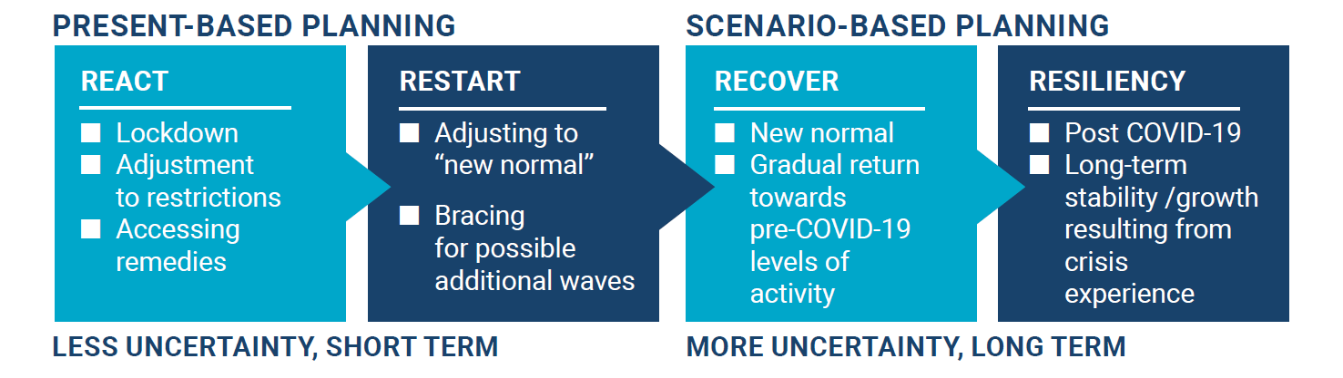
THE FOUR Rs
In each of the possible scenarios, there will be 4 stages – React, Restart, Recover, Resiliency.

Slide 21
PROJECT TIMELINE
Establish your Scenario Planning Working Group.
    This can include any stakeholder who has an interest in your project. For workforce development, it could include employment-focused organizations; education/training institutions; economic development; local government representatives (municipal, county, provincial, federal); industry organizations; businesses; HRPA; Employment Ontario Service Providers; large community organizations.
Research impacts on your focal issue at the local, regional, provincial, national, and international levels.
    Look at think tank reports, economic impacts, talk to stakeholders, read published reports
What are the key economic and social factors determining the future outcomes for your region?

Slide 22
PROJECT TIMELINE
Project team members discussing the project with stakeholders should be able to answer the following questions:
Why are we doing this?
Why does it benefit people in the community?
Why should businesses care about it?

Slide 23
PROJECT TIMELINE
Your Scenario Planning Roundtable meets to have a facilitated discussion.
List of Key Factors/External Forces narrowed down to a list of the most Critical Uncertainties.
Use this info to finalize your list of potential future scenarios.
Collaborate with all project partners to engage with stakeholders to build out each scenario & identify implications/actions required in each scenario.

Slide 24
PROJECT TIMELINE
Members of your Working Group may want to bring this info back to their department/sector/industry to get input on the actions/interventions required for mitigating the economic & employment effects of COVID-19.
Identify key assumptions made in the formulation of each scenario.

Slide 25
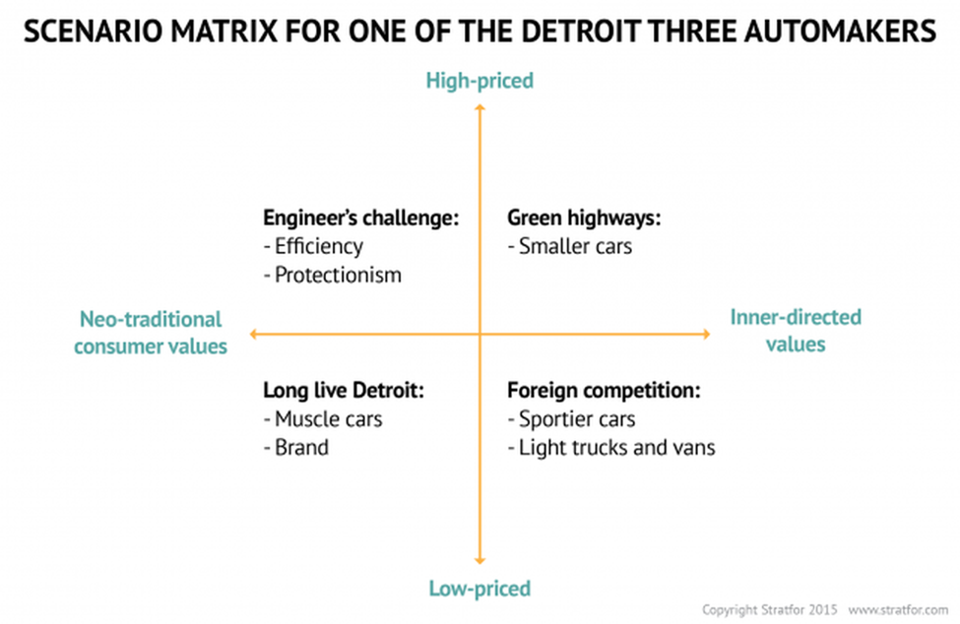
SCENARIOS - Example
This example was created in 1984 for one of the Big-3 Detroit automakers.
The bottom left quadrant was the future they planned around for decades – until the oil crisis, foreign competition, smaller cars, etc. forced them to change direction.

Slide 26
SCENARIOS - Example
SCENARIO MATRIX FOR THE ECONOMIC IMPACT OF THE COVID-19 PANDEMIC

Slide 27
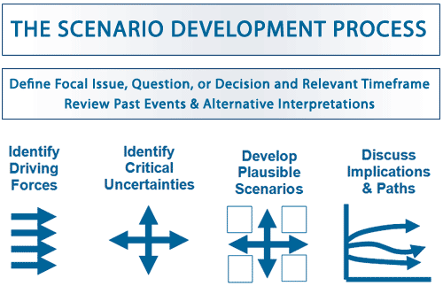
ADDITIONAL VISUALIZATIONS OF THE PROCESS

Slide 28
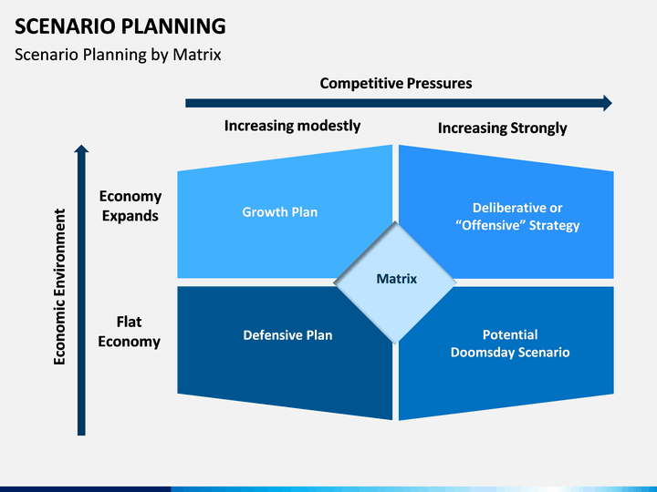
ADDITIONAL VISUALIZATIONS OF THE PROCESS

Slide 29
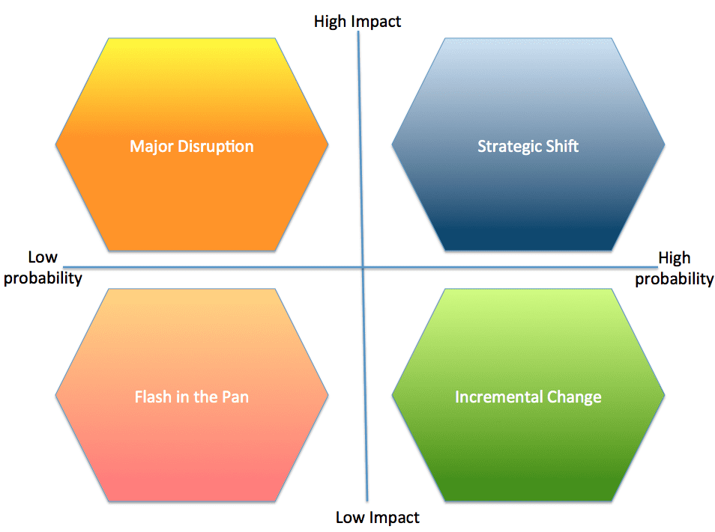
ADDITIONAL VISUALIZATIONS OF THE PROCESS

Slide 30
ADDITIONAL INFORMATION
What is Scenario Planning and how to use it (https://www.smestrategy.net/blog/what-is-scenario-planning-and-how-to-use-it)
Scenario Planning and Strategic Forecasting https://www.forbes.com/sites/stratfor/2015/01/08/scenario-planning-and-strategic-forecasting/#2c9d2da2411a

